Slide 1
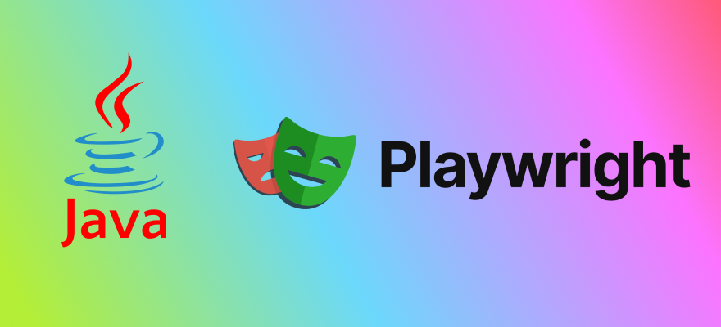
Automation Testing
By- Manas

Slide 2
What is Playwright
Playwright is a modern, open-source automation testing framework developed by Microsoft. It is used for end-to-end (E2E) testing of web applications across different browsers.
Playwright was officially launched by Microsoft in January 2020 as an open-source end-to-end testing framework for web applications.
Playwright allows you to automate browser interactions and provides a robust, reliable, and fast way to test modern web applications across different browsers, including Chromium, Edge, Firefox, and WebKit (Safari).
Playwright excels in end-to-end testing by simulating real user interactions across web applications, from navigating pages to filling forms, clicking buttons, and validating results.

Slide 3
Advantages of Playwright
1. Cross-Browser Support
Automates Chromium, Firefox, and WebKit browsers using the same API.
Works on Windows, macOS, and Linux.
Ensures better cross-browser compatibility testing.
2. Parallel Testing and Fast Execution
Playwright allows for parallel test execution, which significantly reduces testing time.
It’s designed to handle modern web apps with features like dynamic content, images .
3. Multiple Language Support
Support multiple language like Java, JavaScript/TypeScript, Python, C# (.NET)
4. Auto-Wait Capability
Playwright automatically waits for elements to be ready before performing actions.
Reduces flaky tests and eliminates the need for manual waits or sleeps.

Slide 4
Advantages of Playwright
5. Screenshots & Videos Capture
Playwright capture screenshots and videos of test execution out of the box.
Useful for debugging and test evidence.
Automation Codegen
Playwright support codegen which help generate to automation script (By performing the action manually.)
Generate tests by recording your actions. Save them into any language.
7. Support In-Built Assertion
Playwright Support in built Static and Non Static Assertion for validation
Support Headless mode
Playwright runs tests in headless mode by default (no UI), making them faster. And the chances of failure will be reduced.
Headless mode executes the tests without launching the browser’s UI, making the process faster and ideal for CI/CD pipelines

Slide 5
Limitation of Playwright
Limited Mobile and Desktop Automation: Playwright is designed for web application automation only. It cannot test native desktop or mobile applications.
Limited Support for Older Browsers: It supports Chromium, WebKit, and Firefox, but it does not support older browsers like Internet Explorer or older versions of browsers that some legacy apps may still require.
Visual Testing is Not Native: Playwright doesn’t offer built-in visual regression testing (comparing screenshots, colour contras) out of the box.
Smaller Community Compared to Selenium: Although fast-growing, Playwright’s community and ecosystem are still smaller than Selenium/WebDriver, so you may find fewer plugins, libraries, or community-contributed solutions.
Learning Curve: To work on the playwright we should have technical knowledge (languages like: Java, Python, Javascript etc.)

Slide 6
Playwright Installation and Setup
Link: https://playwright.dev/java/docs/intro
<properties> <project.build.sourceEncoding>UTF-8</project.build.sourceEncoding> </properties> <dependencies> <dependency> <groupId>com.microsoft.playwright</groupId> <artifactId>playwright</artifactId> <version>1.32.0</version> </dependency> </dependencies> <build> <plugins> <plugin> <groupId>org.apache.maven.plugins</groupId> <artifactId>maven-compiler-plugin</artifactId> <version>3.10.1</version> <!-- References to interface static methods are allowed only at source level 1.8 or above --> <configuration> <source>1.8</source> <target>1.8</target> </configuration> </plugin> </plugins> </build>

Slide 7
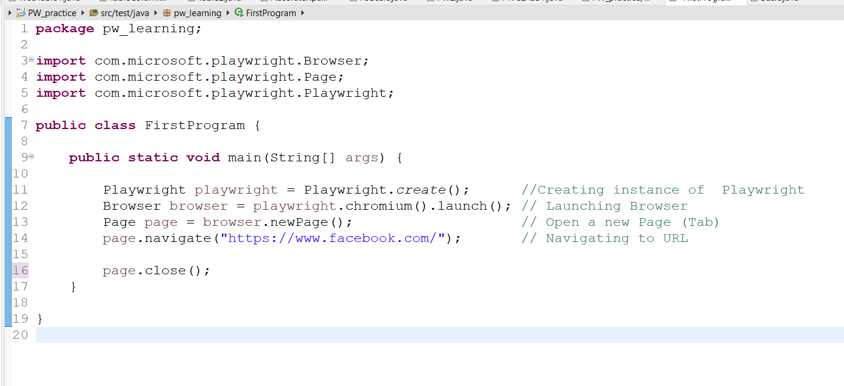
Playwright First Program

Slide 8
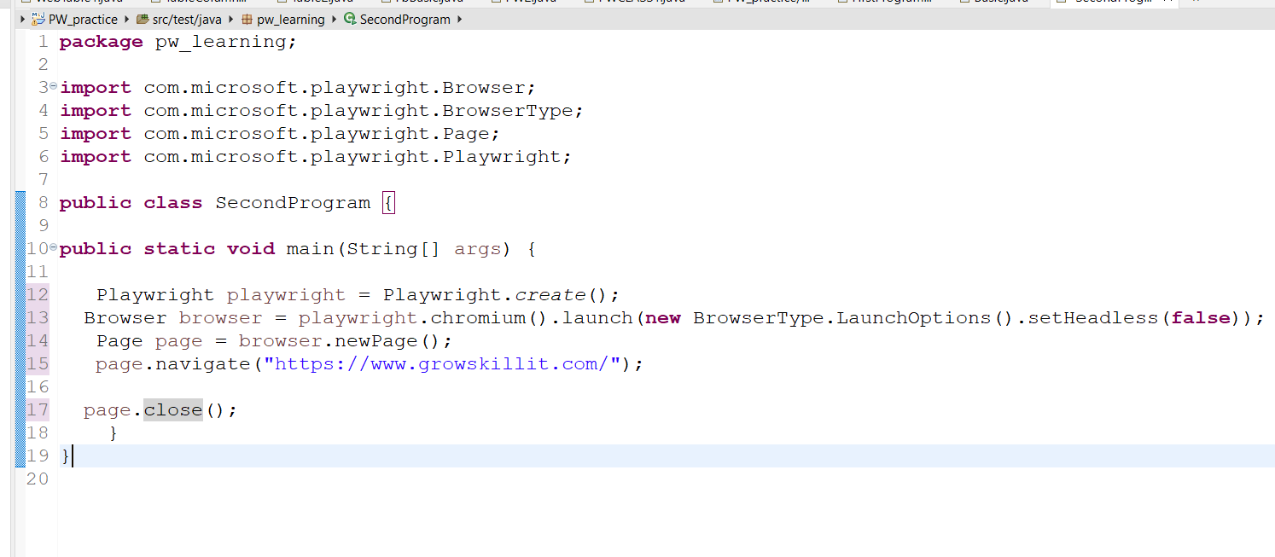
Note: By default, Playwright runs the browsers in headless mode. To see the browser UI, setHeadless option to false

Slide 9
Working with Multiple Browser in Playwright
Chromium → Chrome, Edge
Firefox → Mozilla Firefox
WebKit → Safari
Chrome Browser:
Browser chromium = playwright.chromium().launch(new BrowserType.LaunchOptions().setHeadless(false));
Edge Browser:
Browser chromium = playwright.chromium().launch(new BrowserType.LaunchOptions().setChannel(“msedge”).setHeadless(false));
Firefox Browser:
Browser firefox = playwright.firefox().launch(new BrowserType.LaunchOptions().setHeadless(false));
WebKit Browesr:
Browser webkit = playwright.webkit().launch(new BrowserType.LaunchOptions().setHeadless(false));

Slide 10
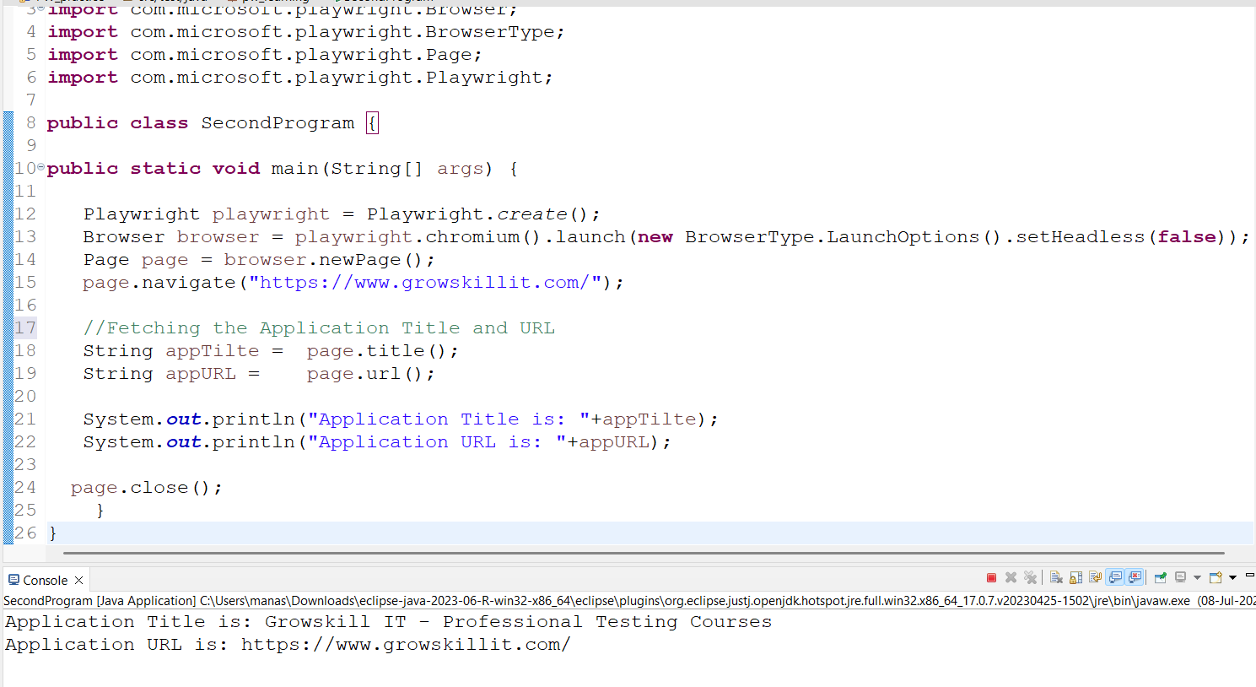
Fetching the Application Title and URL in Playwright
String appTilte = page.title();
String appURL = page.url();

Slide 11
Different ways to find out the element in Playwright
One of the common way to find out the element in playwright is by using locator() function.
Syntax: page.locator("id=email");
page.locator("name=email")
page.locator("xpath=//input[@id='email']") or
page.locator("//input[@id='email']")
page.locator("css=[id='email']") or
page.locator("[id='email']")

Slide 12
Entering the value into textbox
In Playwright, both fill() and type() are used to enter text into input fields, but they have different behaviors and use cases.
1. Using fill() → Fastest & Most Common
Clears the text box and enters the value instantly.
Syntax: page.locator(“id=email").fill("myUsername");
2. Using type() → Simulate Real User Typing
Types each character like a human (with optional delay).
Syntax: page.locator(“id=email").type("myUsername");
Type with delay:
Syntax: page.locator("#username").type("myUsername", new Locator.TypeOptions().setDelay(500)); // 500 ms delay

Slide 13
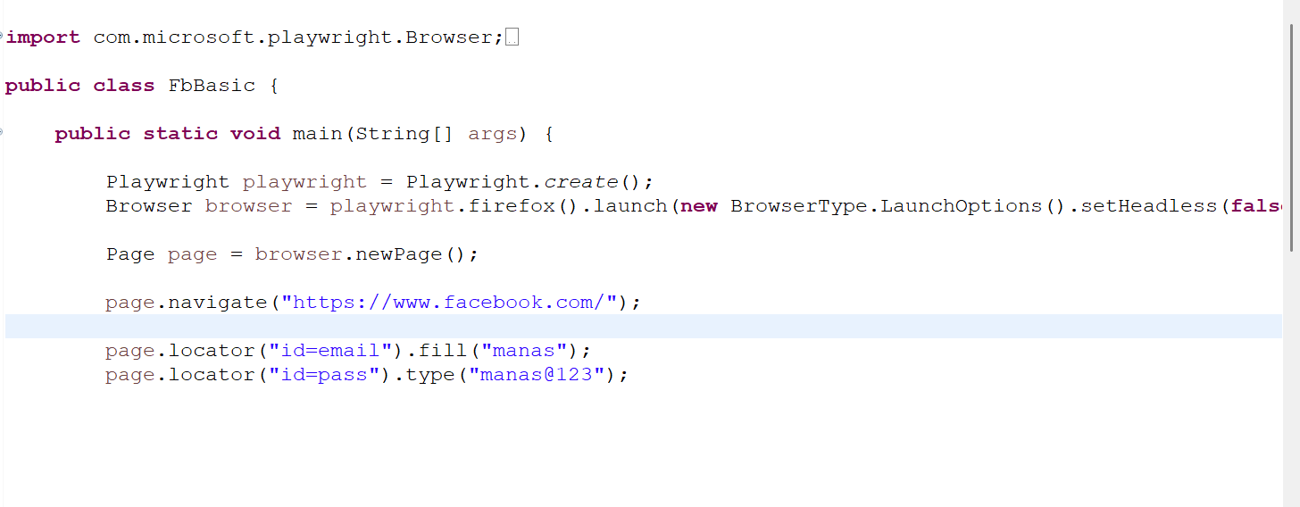
Basic Playwright Snippet for fill() vs. type() function

Slide 14
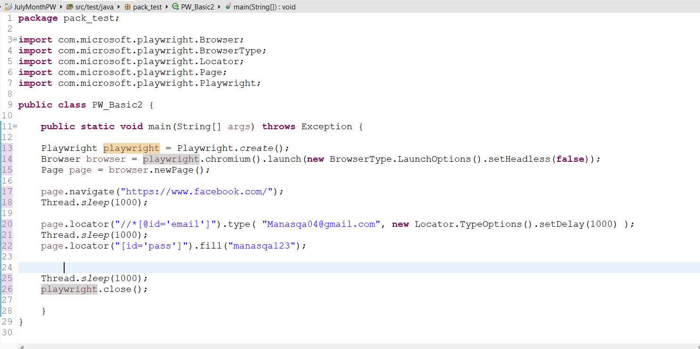
type() method with delay

Slide 15
Difference Between fill() Vs type() function
Feature | fill() | type()
Behavior | Clears the existing value and sets the new value | Types text character by character like a real user
Speed | Instant (fast, no typing delay) | Slower (types each character with optional delay)
Use Case | When you just want to set the value directly | When simulating realistic user typing
Clears Existing Text | Yes (automatically clears before filling) | No (it types after the existing text unless cleared)
Supports Delay | Not Supporting any delay | Yes, supports typing delay per character

Slide 16
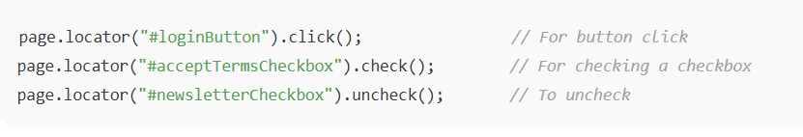
click() and check() function in playwright
click(): It clicks on any clickable element (button, link, check box, radio button, div, etc)
Syntax: page.locator(“id =buttonId").click();
Check(): This ensures that the checkbox or radio button is checked (only clicks if not already checked). This we using only for Check box and Radio button.
Syntax: page.locator("#checkboxId").check();
Note: For Uncheck the checkbox: page.locator("#checkboxId").uncheck();

Slide 17
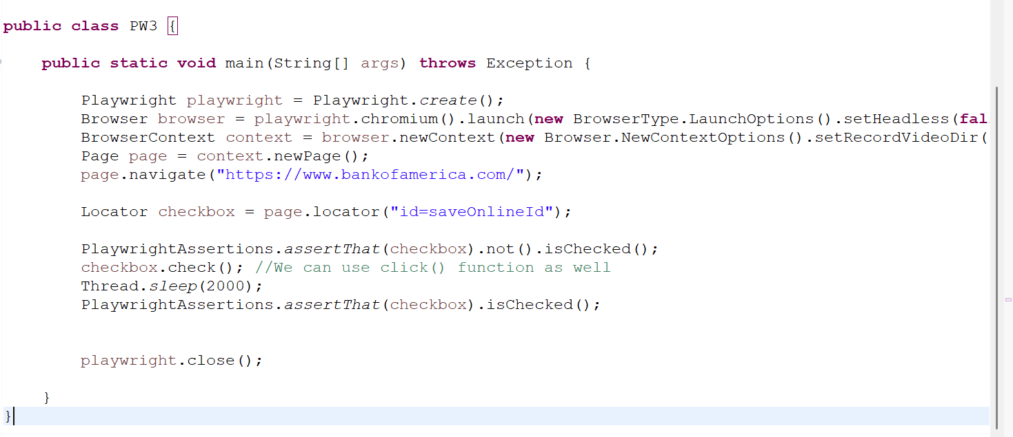
Playwright Checkbox Program with Assertion

Slide 18
List of built-in locators in Playwright
Page.getByRole() to locate by explicit and implicit accessibility attributes.
Page.getByText() to locate by text content.
Page.getByLabel() to locate a form control by associated label's text.
Page.getByPlaceholder() to locate an input by placeholder.
Page.getByAltText() to locate an element, usually image, by its text alternative.
Page.getByTitle() to locate an element by its title attribute.
Page.getByTestId() to locate an element based on its data-testid attribute.

Slide 19
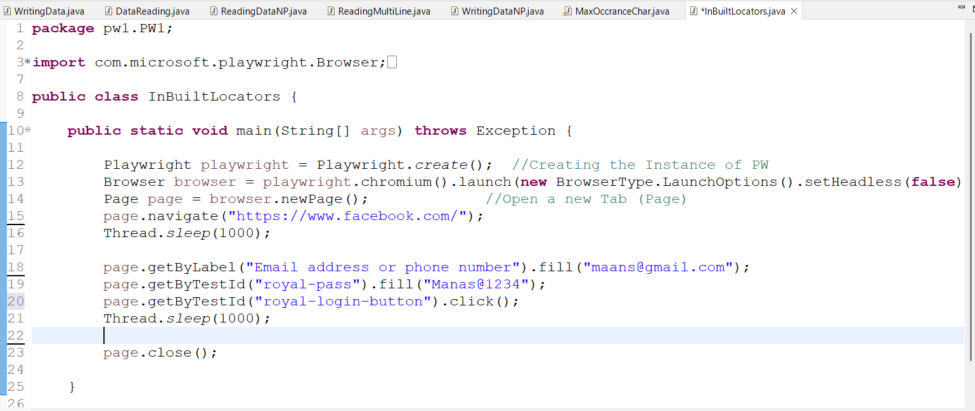
Playwright built-in locators basic program

Slide 20
Working with Dropdown list in Playwright
In Playwright, handling dropdown lists is quite straightforward and different from Selenium because Playwright does not require a special Select class. we can interact with dropdowns (i.e., <select> elements) using the selectOption() method.
Syntax:
page.locator("#day").selectOption("14");
page.selectOption(“locatorValue", "optionValue"); //We can give value or text
Select by value
page.selectOption("locatorvalue", "optionValue");
Select by visible text
page.selectOption(“locatorvalue", new SelectOption().setLabel("Option Text"));
Select by index
page.selectOption("locatorvalue", new SelectOption().setIndex(1));

Slide 21
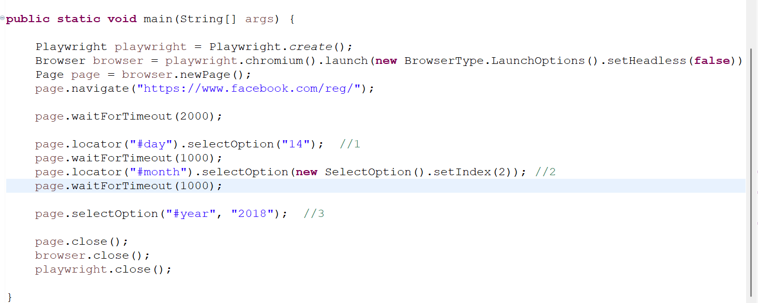
Playwright Dropdown Program

Slide 22
Basic Methods/Commands in Playwright
For Button:
Locator button = page.locator(“id =buttonId");
button.click();
button.hover();
button.dblclick();
button.fill("Some text"); // Input fields
button.type("Some text");
button.press("Enter"); // Keyboard actions
For Checkbox and Radio Button:
page.locator("#checkboxId").click();
page.locator("#checkboxId").uncheck();
page.locator("#radioId").check();
For Dropdown List:
page.locator("#dropdownId").selectOption("optionValue");

Slide 23
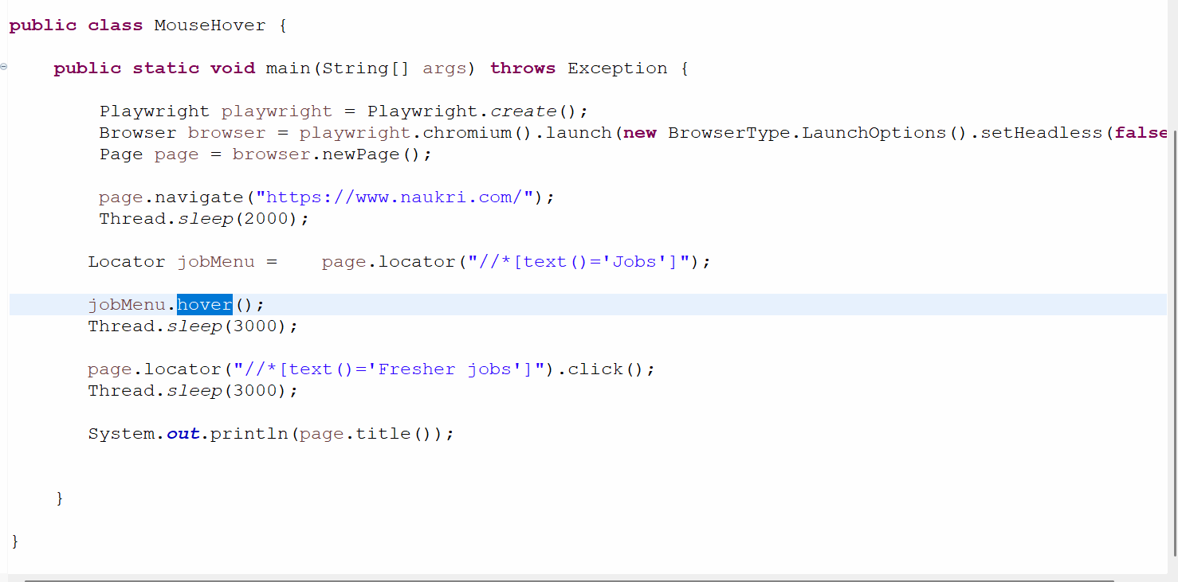
Playwright Program for Mouse Hover

Slide 24
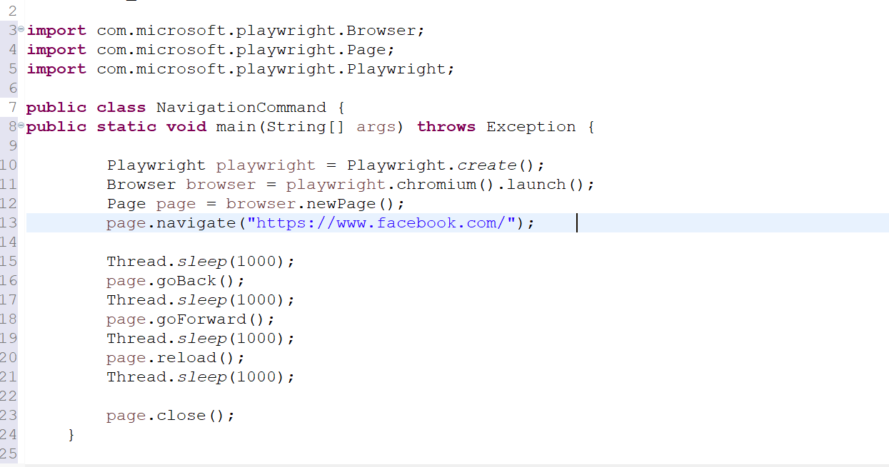
Navigation Command in Playwright
page.navigate("https://growskillit.com");
page.goBack();
page.goForward();
page.reload();

Slide 25
Validation Command in Playwright
isVisible(): To Validate Element is Visible or not
Syntax: locator.isVisible();
Syntax with Assertion: assertTrue(page.locator("text=Login").isVisible());
isEnabled(): To Verify Button is Enabled or not.
Syntax: assertTrue(page.locator("#submitBtn").isEnabled());
isDisabled(): To Verify Button is Disabled or not.
Syntax: assertTrue(page.locator("#submitBtn").isDisabled();
isChecked(): To verify the Checkbox is Checked or not
Syntax: assertTrue(page.locator("#rememberMe").isChecked());
isEditable (): To verify the Textbox and any test field is Editable or not
Syntax: assertTrue(page.locator("#rememberMe").isEditable());

Slide 26
getAttribute(): To get the attribute value of element.
Syntax: String placeholder = page.locator("#username").getAttribute("placeholder");
assertEquals("Enter Username", placeholder);
textContent (): To get the name/text of the Element.
Syntax: locator.textContent();
assertEquals("Welcome", page.locator("h1").textContent());
count(): To count the number of element in webpage
Syntax: locator.count();
int linkCount = page.locator("a").count();
assertTrue(page.locator(".item").count() > 0);
assertEquals(3, page.locator(".card").count());

Slide 27
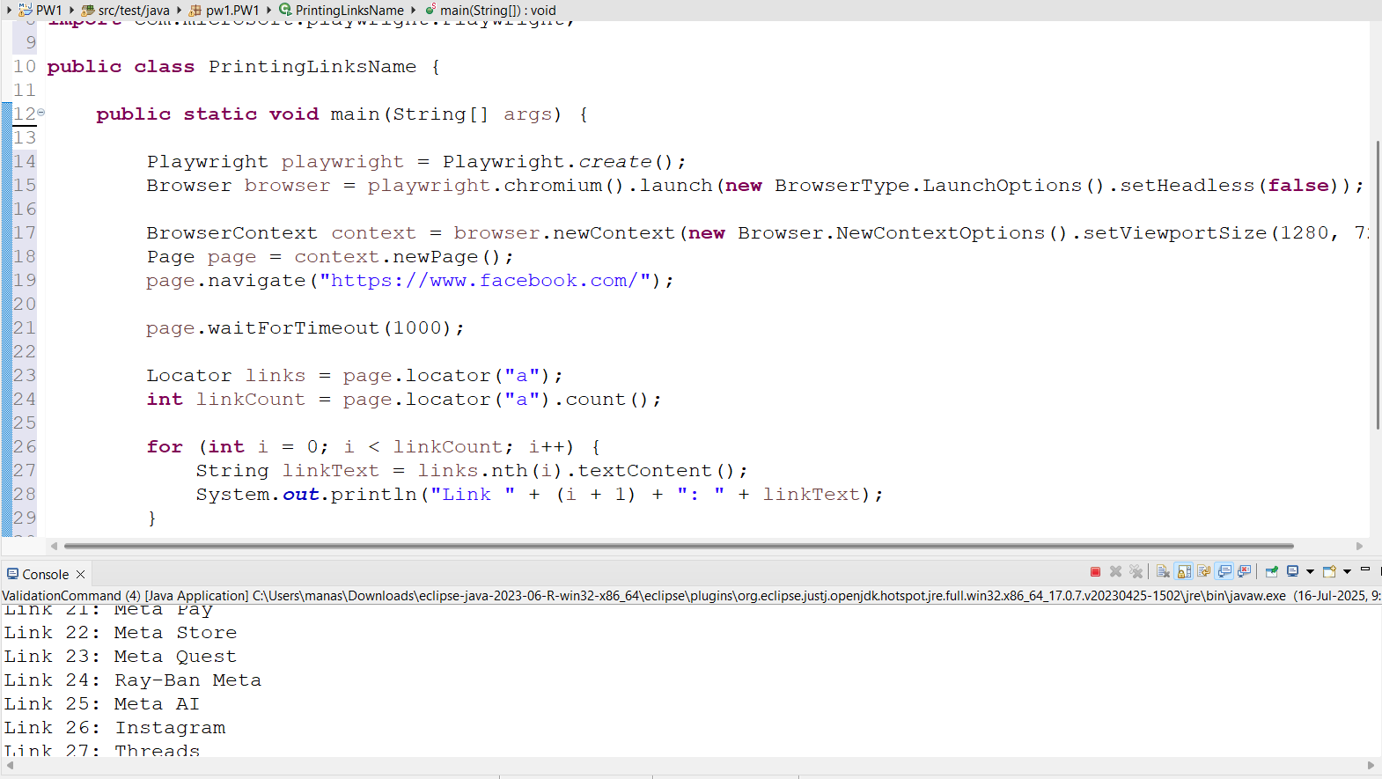
Playwright program for printing all the link name in application

Slide 28
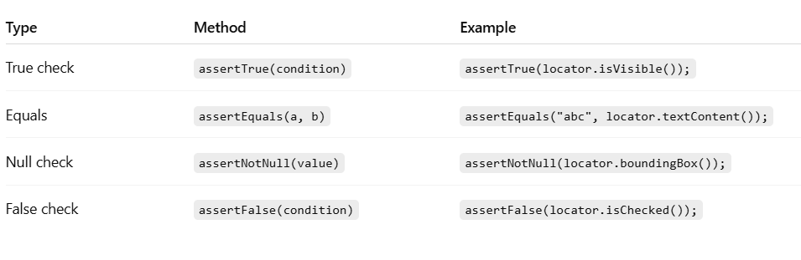
Junit Assertions

Slide 29
Wait Method in Playwright (Synchronization)
page.waitForLoadState(): This command waits until the page reaches a specific loading state before moving to the next step in your script.
Syntax: page.waitForLoadState(); // Waits until the page is fully loaded
page.waitForTimeout(2000): This command waits for a fixed amount of time (in milliseconds) before proceeding.
Note: It's basically a hard wait or Thread.sleep().
Syntax: page.waitForTimeout(2000); // Waits for 2 seconds (2000 ms)

Slide 30
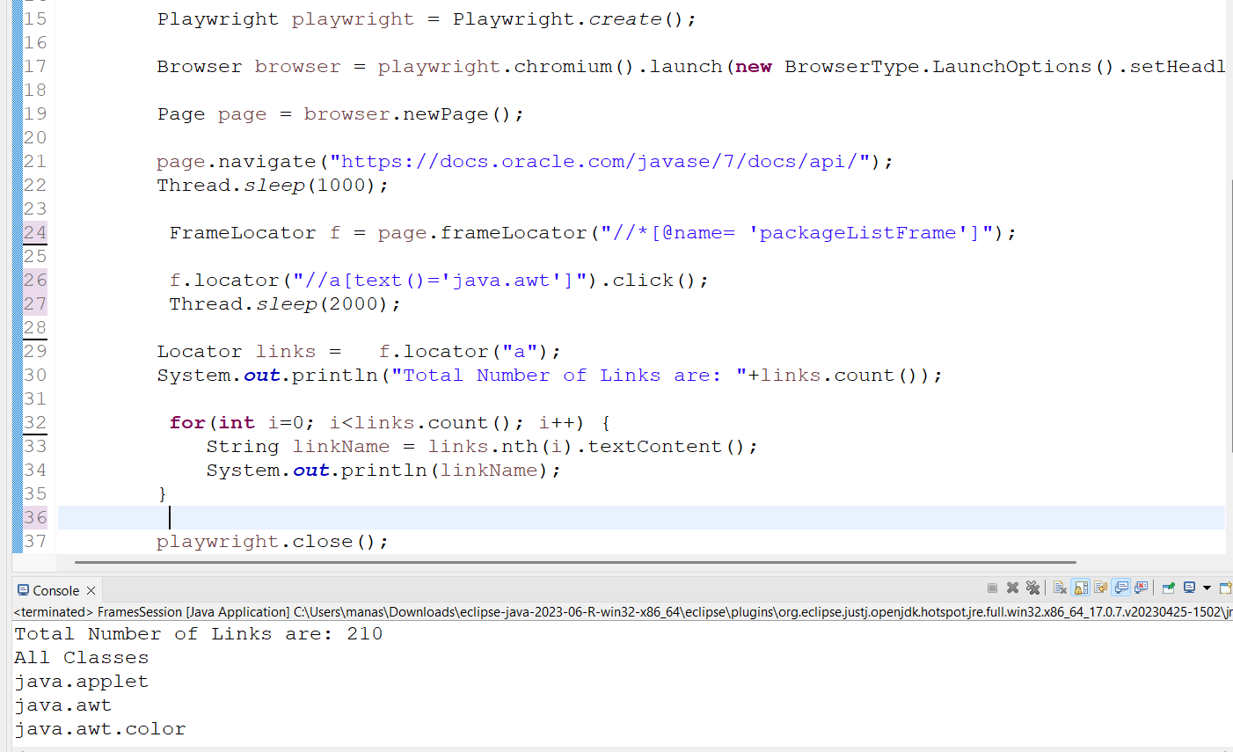
Handling Frames in Playwright
The simple way to handle the frames in playwright is using frameLocator()

Slide 31
Screenshot in Playwright
In Playwright, taking a screenshot is very simple and useful for debugging or visual regression testing. Below are the syntax for capturing the screenshot in playwright.
Syntax: page.screenshot(new Page.ScreenshotOptions() .setPath(Paths.get("screenshot.png")));
We can use a folder like /screenshots/ or custom folder to keep them organized:
Syntax: page.screenshot(new Page.ScreenshotOptions() .setPath(Paths.get("/screenshot/homepage.png")));
or
String p = "screenshots/"+page.title()+".png";
page.screenshot(new Page.ScreenshotOptions().setPath(Path.of(p)));

Slide 32
Taking Screenshot of full page:
In Playwright we can take the screenshot of full page/application by using below command.
Syntax: page.screenshot(new Page.ScreenshotOptions().setPath(Paths.get("screenshot1.png")).setFullPage(true));
Specific Element Screenshot
Syntax: Locator logo = page.locator("img#logo");
logo.screenshot(new Locator.ScreenshotOptions().setPath(Paths.get("logo.png")));

Slide 33
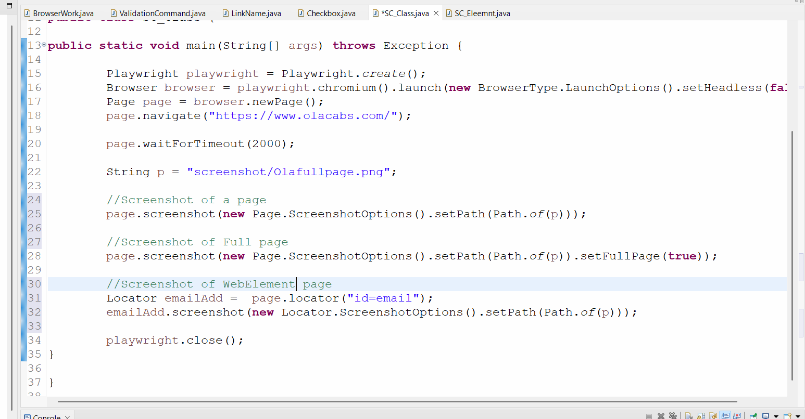

Slide 34
BrowserContext option
For maximizing the Browser
Syntax: BrowserContext context = browser.newContext(new Browser.NewContextOptions().setViewportSize(1920, 1080)); // sets browser window size
browser.newContext() -> This creates a new browser context. A browser context is like a fresh browser profile. or It creates a new isolated browser session.
new Browser.NewContextOptions() -> Specifies configuration options for that session.
setViewportSize(1920, 1080) -> Sets the visible page area to (1920px × 1080px)
For Video Recording:
Syntax: BrowserContext context = browser.newContext(new Browser.NewContextOptions().setRecordVideoDir(Paths.get("videoRec/")));

Slide 35
Playwright Codegen
In Playwright, the codegen functionality is a powerful feature that helps you automatically generate test scripts by recording your actions in the browser.
How Playwright Codegen works:
Opens a browser.
Records all your interactions (clicks, typing, navigation, etc.).
Generates Playwright code (in Java, JavaScript, Python, or C#).
Helps you build automation scripts quickly without writing code manually.
Command To Use Codegen
Syntax: page.navigate("https://www.bankofamerica.com/");
page.pause(); //For starting Codegen
Note: By using above command This opens a browser and starts recording. As you interact with the page, Playwright shows the equivalent code in real-time.

Slide 36
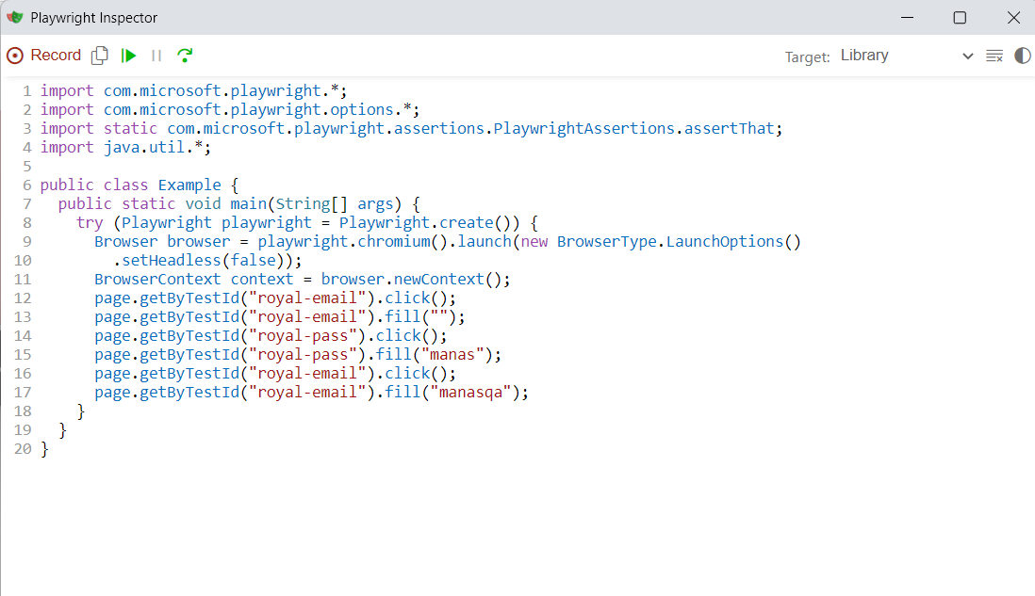
Why to use Codegen:
Faster test creation – saves time.
Accurate selectors – Playwright picks the best selectors (e.g., getByRole, getByText).
Learning tool – great for beginners to understand how to write Playwright scripts.

Slide 37
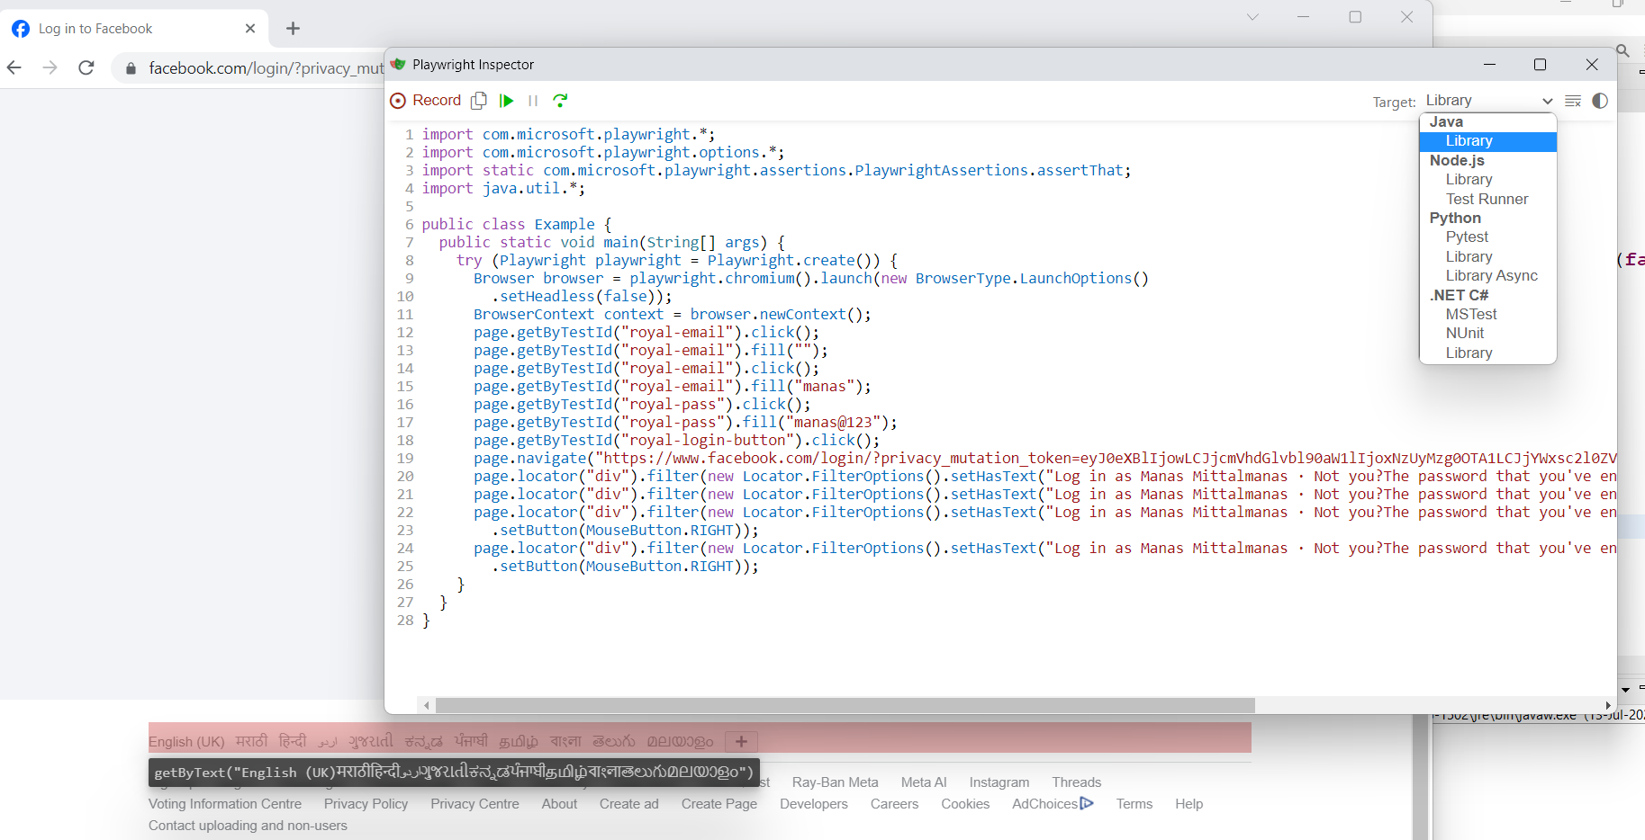
Playwright Codegen

